Slide 1





FACIAL RECOGNITION LOCK
PROJECT
By Group H

Slide 2
TABLE OF CONTENTS
Who are we?
What was our objective for this period?
How about a database?
Facial Recognition algorithm
Raspberry app
Desktop app
Demonstration
FACIAL RECOGNITION LOCK
PROJECT
By Group H
01
02
03
04
05
06
07

Slide 3

WHO ARE WE?
TABLE OF CONTENTS
Who are we?
What was our objective for this period?
How about a database?
Facial Recognition algorithm
Raspberry app
Desktop app
Demonstration
01
02
03
04
05
06
07
We are a team of seven IT students working on an innovative project to create a facial recognition lock. Our cutting-edge technology scans your face to unlock doors, providing a seamless and secure access solution.

Slide 4







PROJECT OBJECTIVES
WHO ARE WE?
We are a team of seven IT students working on an innovative project to create a facial recognition lock. Our cutting-edge technology scans your face to unlock doors, providing a seamless and secure access solution.
OBJECTIVE 03
Ensure data security and privacy protocols are robust and compliant with industry standards
OBJECTIVE 02
Enhance the user interface for an intuitive and user-friendly experience
OBJECTIVE 01
Develop and refine the facial recognition algorithm
and integrate with the lock mechanism.

Slide 5


HOW ABOUT A DATABASE?
PROJECT OBJECTIVES
Purpose
To support the development of a desktop application, a Raspberry Pi app, and a facial recognition algorithm.
OBJECTIVE 01
OBJECTIVE 02
OBJECTIVE 03
Develop and refine the facial recognition algorithm
and integrate with the lock mechanism.
Enhance the user interface for an intuitive and user-friendly experience
Ensure data security and privacy protocols are robust and compliant with industry standards
Tables and Their Functions
ADMIN: Stores email and password for login purposes.
EMPLOYEE: Contains employee details.
LOG: Tracks entry logs
ROOM: Manages room information.

Slide 6

FACIAL RECOGNITION ALGORITHM
PROJECT OBJECTIVES
HOW ABOUT A DATABASE?
Purpose
To support the development of a desktop application, a Raspberry Pi app, and a facial recognition algorithm.
Tables and Their Functions
ADMIN: Stores email and password for login purposes.
EMPLOYEE: Contains employee details.
LOG: Tracks entry logs
ROOM: Manages room information.
01
02
Face Detection
Utilize algorithm ... to scan the input and detect facial regions
Face Alignment
Apply geometric transformations to align facial landmarks (e.g., eyes, nose, mouth) to a predefined template
03
OBJECTIVE 02
Enhance the user interface for an intuitive and user-friendly experience
04
Feature Extraction
Extract distinctive features from the aligned face for accurate identification
Face Matching
Compare extracted features against stored facial data to identify or verify the person.
OBJECTIVE 03
OBJECTIVE 01
Ensure data security and privacy protocols are robust and compliant with industry standards
Develop and refine the facial recognition algorithm
and integrate with the lock mechanism.

Slide 7
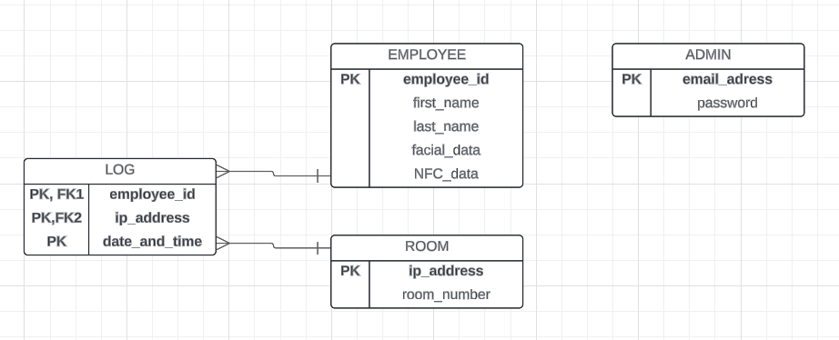
FACIAL RECOGNITION ALGORITHM
01
02
Face Detection
Utilize algorithm ... to scan the input and detect facial regions
Facial Landmarks
Identify key points on the face, such as the eyes, nose, and mouth.
03
04
Feature Extraction
Extract distinctive features from the aligned face for accurate identification
Face Matching
Compare extracted features against stored facial data to identify or verify the person.

Slide 8
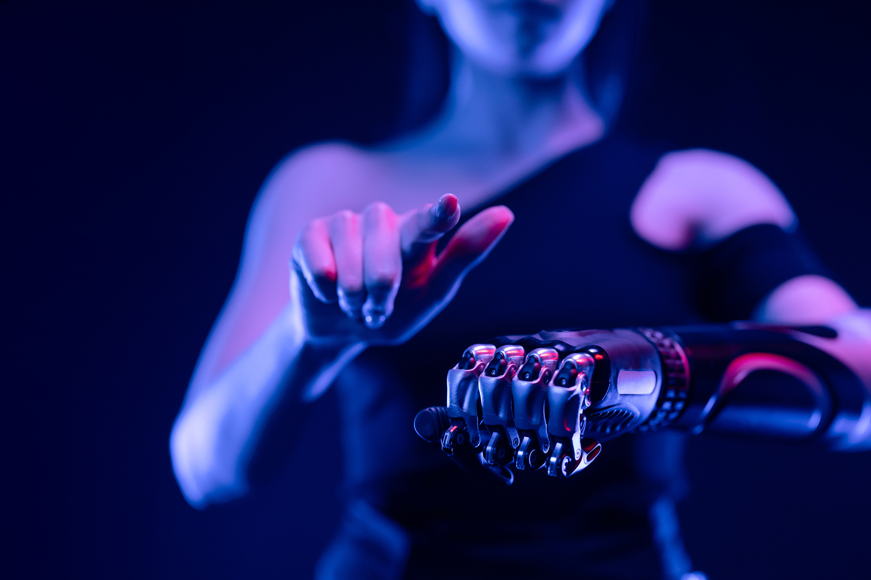

RASPBERRY PI APP
FACIAL RECOGNITION ALGORITHM
Functionality: Allows users to select the room they want to enter and choose between facial recognition or NFC card scanning for door access.
Purpose: Provides a flexible, user-friendly interface for secure and efficient access control.
Functionality: Allows users to choose between facial recognition or NFC card scanning for door access.
Purpose: Provides a flexible, user-friendly interface for secure and efficient access control.
01
02
03
04
Face Detection
Utilize algorithm ... to scan the input and detect facial regions
Facial Landmarks
Identify key points on the face, such as the eyes, nose, and mouth.
Feature Extraction
Extract distinctive features from the aligned face for accurate identification
Face Matching
Compare extracted features against stored facial data to identify or verify the person.

Slide 9
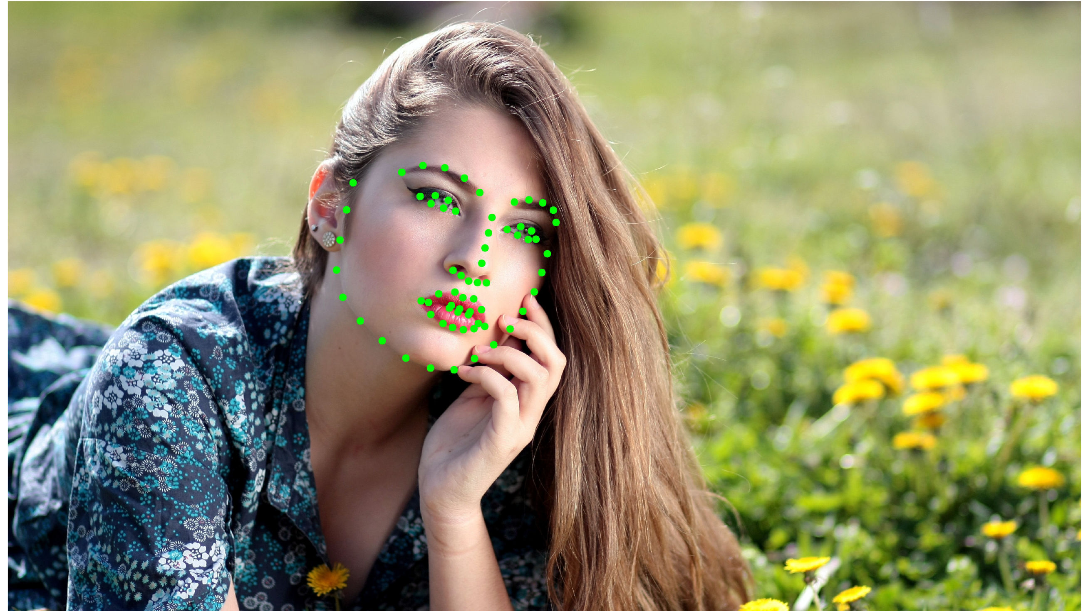
FACIAL RECOGNITION ALGORITHM
RASPBERRY PI APP
Functionality: Allows users to choose between facial recognition or NFC card scanning for door access.
Purpose: Provides a flexible, user-friendly interface for secure and efficient access control.
04
Face Matching
Compare extracted features against stored facial data to identify or verify the person.
03
Feature Extraction
Extract distinctive features from the aligned face for accurate identification
02
Facial Landmarks
Identify key points on the face, such as the eyes, nose, and mouth.
01
Face Detection
Utilize algorithm ... to scan the input and detect facial regions

Slide 10
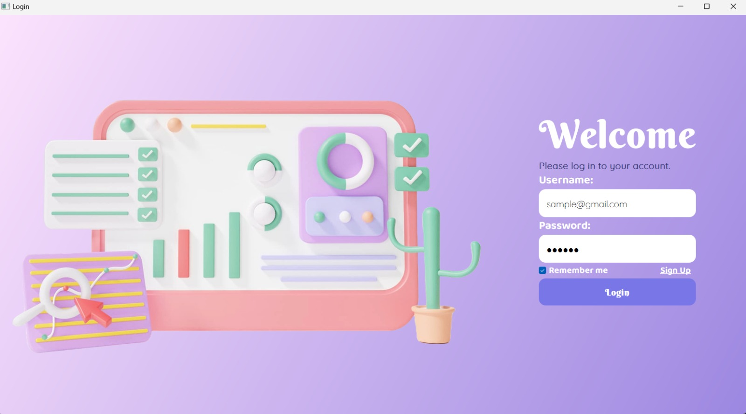
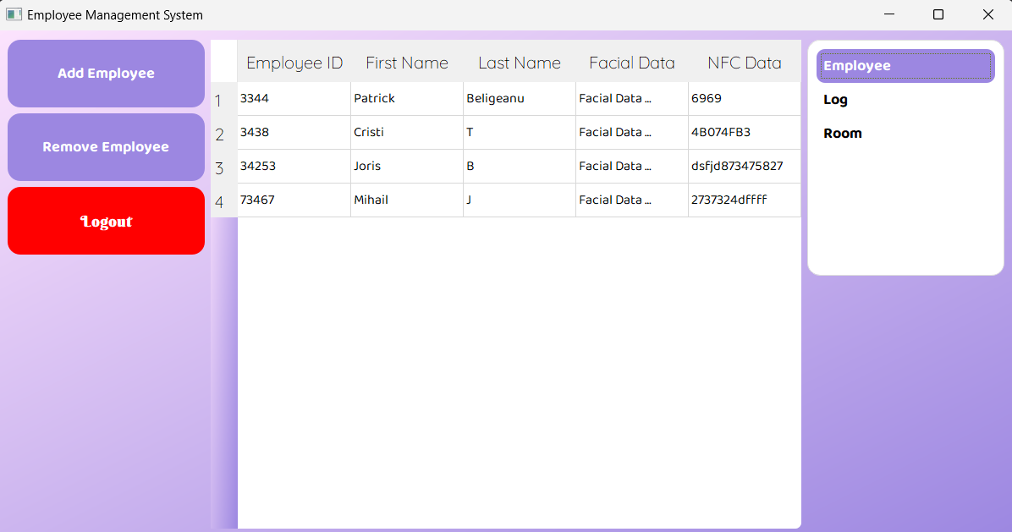
PURPOSE
DESKTOP APPLICATION
To manage and browse the database tables (ADMIN, EMPLOYEE, LOG, ROOM) for the facial recognition lock system.
RASPBERRY PI APP
FEATURES
Functionality: Allows users to choose between facial recognition or NFC card scanning for door access.
Purpose: Provides a flexible, user-friendly interface for secure and efficient access control.
Login: Secure login for administrators.
Database Management:
View and edit employee details, including adding and removing employees.
Access Logs: Track and review log entries to see which employees entered specific rooms at given times.
Room Management: Manage room details, including IP addresses and room numbers.
OBJECTIVE
Provide administrators with a comprehensive tool for overseeing and maintaining the facial recognition lock system.
04
03
Face Matching
Compare extracted features against stored facial data to identify or verify the person.
OBJECTIVE 02
Enhance the user interface for an intuitive and user-friendly experience
Feature Extraction
Extract distinctive features from the aligned face for accurate identification
02
01
Face Alignment
Apply geometric transformations to align facial landmarks (e.g., eyes, nose, mouth) to a predefined template
Face Detection
Utilize algorithm ... to scan the input and detect facial regions

Slide 11



DESKTOP APPLICATION
PURPOSE
Demonstration
To manage and browse the database tables (ADMIN, EMPLOYEE, LOG, ROOM) for the facial recognition lock system.
FEATURES
Login: Secure login for administrators.
Database Management:
View and edit employee details, including adding and removing employees.
Access Logs: Track and review log entries to see which employees entered specific rooms at given times.
Room Management: Manage room details, including IP addresses and room numbers.
OBJECTIVE
Provide administrators with a comprehensive tool for overseeing and maintaining the facial recognition lock system.

Slide 12
THANK YOU!
Demonstration

Slide 13

THANK YOU!

